Slide 1
INVENTORY MANAGEMENT
- The Chosen Ones

Slide 2
TABLE OF CONTENTS
01
02
PROBLEM
DETAILED EXPLANATION
03
04
MECHANISM
CIRCUITS
The Problem Statement and Approach towards the solution.
Solution and It’s Explanation in depth
3-D Model and how it works
Circuit Diagrams and 3-D model of the project

Slide 3
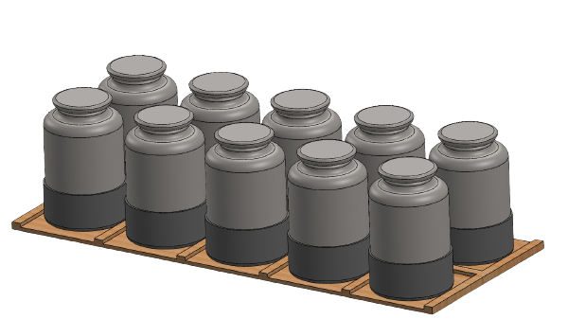
ABOUT US
We are Second-year students pursuing a Bachelor of Technology in different fields. We are a team of Robotic Enthusiasts trying to make some different projects related to different fields of robotics.
-The Chosen Ones

Slide 4
01
PROBLEM STATEMENT
The problem our process improvement project will address

Slide 5
PROBLEM STATEMENT
Maintaining the kitchen inventory has always been an issue for all households. People return from shops only to realize that they missed out on something. At times you find you are out of stock on Sunday morning when the shops are closed.
Kitchen Inventory includes (but is not limited to):
Solids like rice grains, wheat flour, salt, sugar, various Spices.
Fluids like oil, vinegar, kerosene.
The containers holding these items come in various capacities. They are placed in cupboards. But the location within may not always remain the same.
With this situation in mind, design an IoT solution to keep track of kitchen inventory. The solution must be scalable, practical, and easy to use. You may also create a usage history for various commodities.

Slide 6
APPROACH
IDEA
WEIGHT
SENSING
DATA
COLLECTION
Data is collected using micro-controller and is sent to Web server for analysis.
We are using a weight sensor to check the amount of weight present in the container
Detect the amount of goods present in the container and send the data to the web server and check whether the container is close to getting empty or not

Slide 7
DETAILED EXPLANATION

Slide 8
TECHNICAL SKILLS
WEIGHT SENSING
CONTAINER INDEXING
DATA ANALYSIS
POWER SUPPLY
Sensing the weight contained inside the container using sensor
The analysis of which container is going to get empty shortly
The most important aspect of any project.
Indexing of the containers to get exact information about which container is going to get empty soon and what is contained inside it

Slide 9
WEIGHT SENSING
We are using a Load Cell attached to a HX711 load cell amplifier which is connected to micro-controller(ESP-8266).
The load cell is used to get data on how much weight is present in the container. This data is amplified by HX711 for weight calculation.
The micro-controller (ESP8266) takes this data and sends this data to web server for Data Analysis
The idea here is to check the weight in the container and notifying the consumer when the container is at 15 to 20 percent of the initial weight

Slide 10
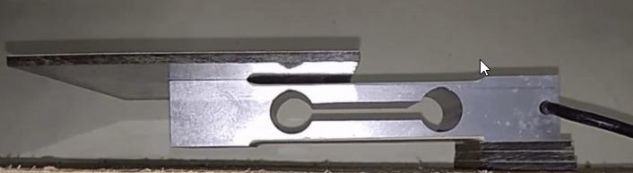
CONTAINER INDEXING
We are using separate circuits for every container to measure the weight of the thing contained inside it.
Not a single circuit of any container is connected in any way.
The Micro-controller (ESP8266) of a single circuit will stay in contact only with web server and none of the other micro-controllers of other circuits.
In this way, we can easily do indexing of containers because of which we can provide exact information of which container is about to get empty and what is stored inside it.
The data of indexing is also sent to the web server along with the data acquired by weight sensing for Data Analysis.

Slide 11
DATA ANALYSIS
The data which was sent to web server will be analyzed to get the required details.
The remaining quantity of goods in the container, will be checked by the program which will be running on the web server.
If the quantity of the remaining goods is more then no notification will be sent. But if the quantity of goods inside the container gets less from a certain limit (specified by user), then a notification will be sent to the user notifying about which container is going to get empty and what is stored inside it.
The idea here is to use the data given by the micro-controller (ESP8266) for analyzing the amount of goods present in the container and notifying the user.

Slide 12
POWER SUPPLY
When the container is placed in the cupboard, there will be a continuous power supply for the circuit.
Because of this, we can power the circuit indefinitely to get the required data.
When the container is taken out of the cupboard, there will be breakage in the continuous power supply.
So, we have attached a portable battery along with the circuit to power it when the container is not at its place inside the cupboard.
Charging pins are placed in the cupboard in such a way that, whenever the container is placed back in its place inside the cupboard after its usage, the pins will get connected to the battery and the battery will charge again till its next usage.
In order to save the power and make our system as efficient as possible we are going to induce deep sleep mode in our module for a custom amount of time.
Here, we have used two types of power supply, first when the container is placed inside the cabinet in any place and the second when it is taken out of the cabinet for usage.

Slide 13
TECHNICAL SOLUTION
Here as the main purpose of this project is to make an efficient system to maintain inventory in the kitchen we tried to make it as efficient inexpensive and scalable as possible.
For the approach we decided to attach a mechanism at the bottom of the storage container. The mechanism is going to have a really simple circuit comprising of ESP-8266 micro-controller a weight load cell and a battery to power everything along with an HX-711 board to help ESP-8266 analog pin to note the weight.
Now the ESP-8266 is going to be operated in such a battery cycle that it sends the weight recorded by the load cell after every 12/custom hours to a website that keeps a record of the status of whether the specific thing is at the threshold level to inform the user. The chip will only send the data to the website when the container is at that level.
If a container reaches the level the website will send the notification to the user and it won't vanish until the container is re-filled.
In this way this system is efficient, scalable, and as simple as it could get.

Slide 14
TECHNICAL PROBLEMS
Our main objective for this project was to find a way to find out how much good is present in a given container and with a large variety of containers in the market from transparent ones to opaque ones we had to find a way to sense the amount of good present.
Container indexing is another challenge where we had no information regarding where a container might be placed and as it is random the place of containers might change causing trouble for weight sensors due to different densities of different goods.
We solved this problem of container indexing by using separate circuits for every container and by it getting exact information of which container is about to get empty and what is stored inside it.
The most optimal answer was to use a weight sensor which helps reduce cost as well as give us a value in weight that can be calibrated to use it to check for optimal conditions.

Slide 15
FLOW CHART
Container
The ESP-8266 send a notification to the website that is pre built which in turn sends notification to the consumer
If the weight of the container is less than the threshold weight.
Module
Portable container containing all the circuitry and weight sensor
The ESP-8266 checks the weight of the container every 24 hours after activation
If the weight of the container is more than the threshold weight.
The ESP-8266 stays idle and no data is sent to the database due to the threshold amount not reached

Slide 16
MECHANISM

Slide 17
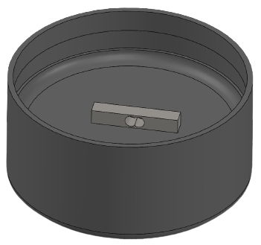
ESP8266 POSITION
As shown in the image, the user will have to just insert an extension below container to use the system.
This extension contains the circuitry of the system.
The height of the extension is 10 CM from which, the container will be inserted and placed on the load cell, in the above 5 CM and the remaining part will consists ESP8266 and HX711 module.
Excess space is allotted to the circuitry part because we will pack whole circuit between cushionings, so that even if the container get damaged by any cause there will be very less effect on the circuitry.

Slide 18
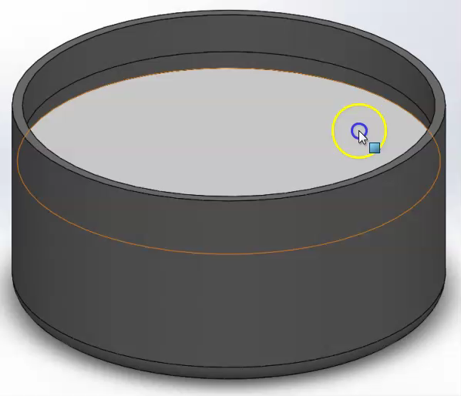
ESP8266 POSITION
As shown in the video, There is a plate separating the load cell and the container part.
First of all this will limit the interaction of load cell with the different thing which will help to increase the life of load cell.
Secondly, the separation plate will help to balance the container above the load cell.
Also it will enhance the look of the mechanism because no part of the circuit is visible to the user.

Slide 19
COST ESTIMATION FOR ONE CONTAINER
COMPONENTS | COST
Load Cell | 200
HX711 Module | 54
ESP8266 | 248
TOTAL | 502

Slide 20
CIRCUITS

Slide 21
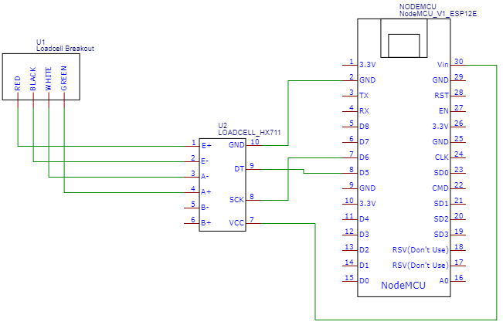
CIRCUIT DIAGRAM
This is the circuit diagram which shows the interfacing of all the components which are used in our system that is present inside the container.
We have tried to make the circuit as simple as possible to avoid the possible complications.

Slide 22
THANK YOU!

